Slide 1
Topics will Be Covered:
Open and Short Circuit
Series Parallel DC Circuit
REDUCE AND RETURN APPROACH
BLOCK DIAGRAM APPROACH
Ladder Networks

Slide 2
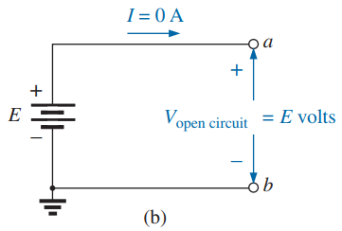
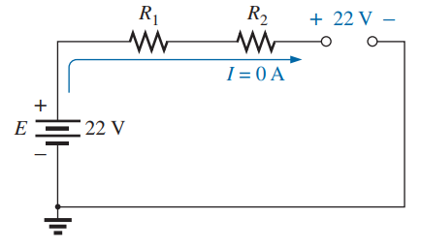
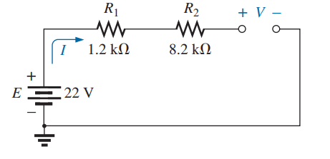
6.8 OPEN CIRCUITS
An open circuit is two isolated terminals not connected by any kind of element.
An open circuit can have a potential difference (voltage) across its terminals, but the current is always zero (0) amperes.
I_{oc} = 0 A R_{oc} = ∞ (Infinite)
EXAMPLE 6.27.1 Determine the unknown voltage (V) and current (I) for the following network.

Slide 3
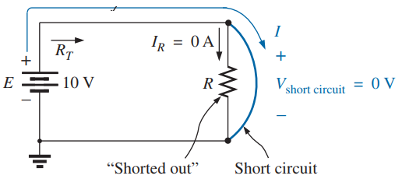
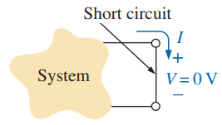
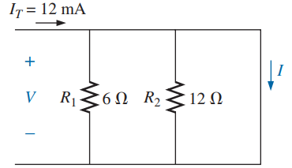
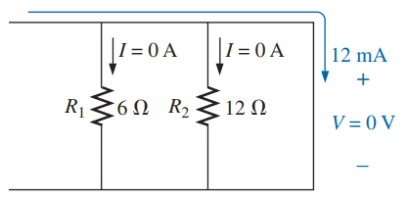
6.8 Short CIRCUITS
A short circuit is a very low resistance, direct connection between two terminals of a network.
Aa short circuit can carry a current of a level determined by the external circuit, but the potential difference (voltage) across its terminals is always zero (0) volts.
V_{sc} = 0 A R_{sc} = 0 (Zero)
EXAMPLE 6.27.2 Determine the unknown voltage (V) and current (I) for the following network.
3

Slide 4
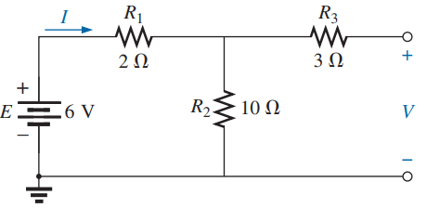
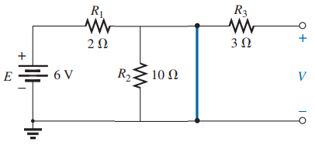
EXAMPLE 6.28.1 Determine the unknown voltage (V) and current (I) for the following network.
I₃=0
Due to the open circuit, the current flow (I₃) through the R₃ is zero. Thus, the current I flows through R₁ and R₂ and V is equal to the voltage drop across the resistance R₂.
V₃=0
I
EXAMPLE 6.28.2 Determine the unknown voltage (V) and current (I) for the following network.
I
I
I₃=0
Due to the open circuit, the current flow (I₃) through the R₃ is zero and since R₂ is shorted the current flow (I₂) through the R₂ is zero. Thus, the current I flows through R₁ and short circuit and V = 0 V.
V₃=0
I₂=0
I
4

Slide 5
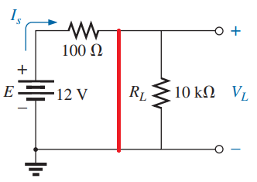
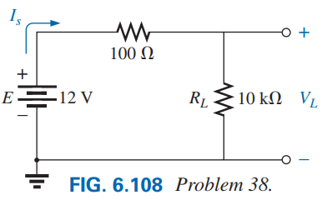
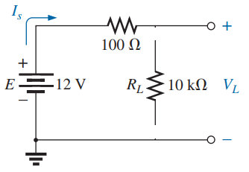
Problem 38 [Ch 6] A For the network in Fig. 6.108:
(a) Determine I_{s} and V_{L}.
(b) Determine I_{s} if R_{L} is shorted out.
(c) Determine V_{L} if R_{L} is replaced by an open circuit.
(b)
(c)

Slide 6
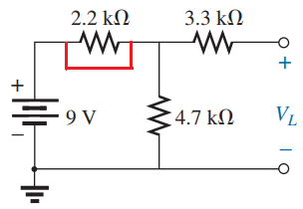
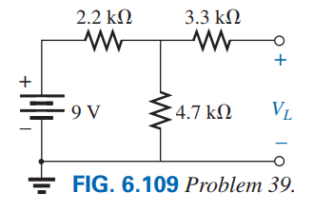
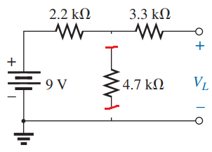
Problem 39 [Ch 6] For the network in Fig. 6.109:
a. Determine the open-circuit voltage V_{L}.
b. If the 2.2 kΩ resistor is short circuited, what is the new value of V_{L}?
c. Determine V_{L} if the 4.7 k Ω resistor is replaced by an open circuit.
6

Slide 7
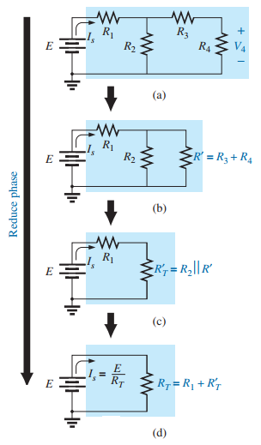
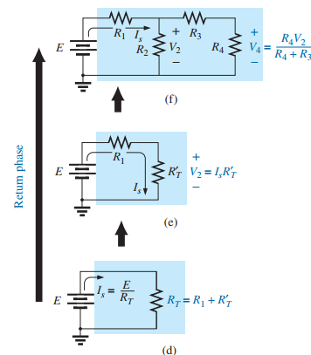
7.3 REDUCE AND RETURN APPROACH
7

Slide 8
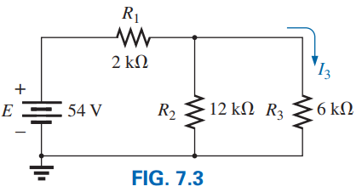

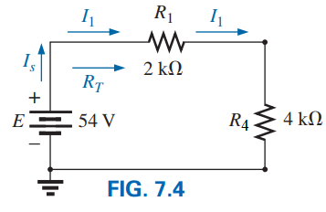


EXAMPLE 7.1 Find current I₃ for the series-parallel network in Fig. 7.3.
Solution: Checking for series and parallel elements, we find that resistors R₂ and R₃ are in parallel. Their total resistance is:
Redraw the circuit showing the calculated resistance R₄.
Now, resistors R₁ and R₄ are in series, resulting in a total resistance of
The source current is then determined using Ohm’s law:
Returning to Fig. 7.3, we find the current I₃ as follows:
8

Slide 9
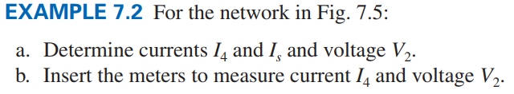
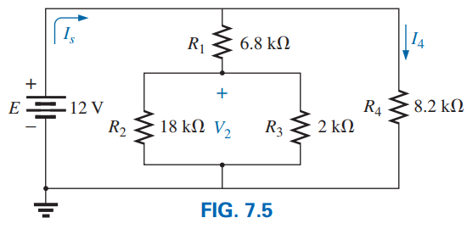


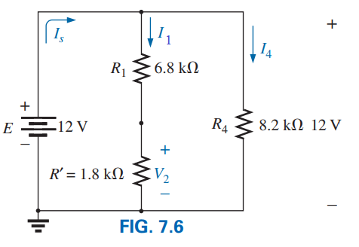

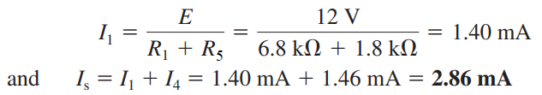
Solution:
Practice Book Problem [SECTIONS 7.2–7.5 Series Parallel Networks] Problems: 1 ~ 24
9

Slide 10
7.4 BLOCK DIAGRAM APPROACH
10

Slide 11
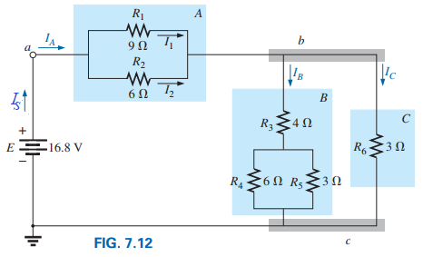
EXAMPLE 7.4 Determine all the currents and voltages for the series-parallel network in Fig. 7.12.
Solution:
11

Slide 12
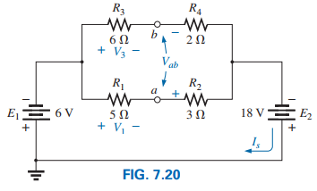
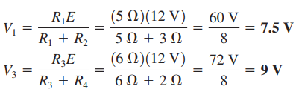
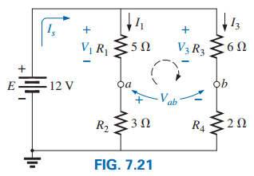

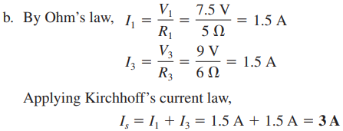
EXAMPLE 7.7
a. Find the voltages V₁, V₃, and V_{ab} for the network in Fig. 7.20. b. Calculate the source current I_{s}.
Solution:
12

Slide 13
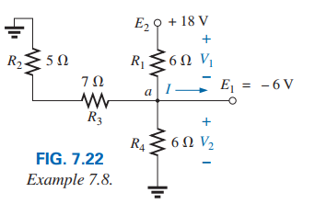
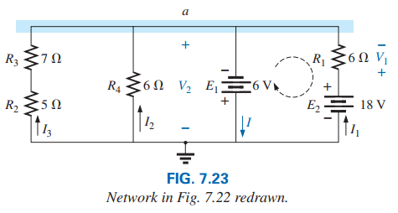
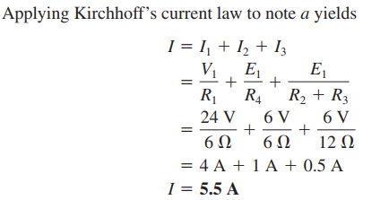

EXAMPLE 7.8 For the network in Fig. 7.22, determine the voltages V₁ and V₂ and the current I.
Solution:
Applying Kirchhoff’s voltage law:
Applying Kirchhoff’s voltage law:
13

Slide 14
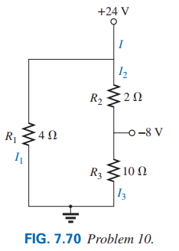
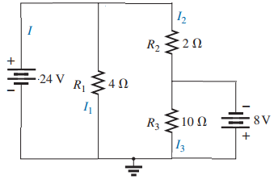
Problem 10:
a. Find the magnitude and direction for current I, I₁, I₂, and I₃, for the network in Fig. 7.70.
b. Indicate their direction on Fig. 7.70.
Solution: Voltage drop across the resistance R₁ equal to 24 V. So:
Voltage drop across the resistance R₃ equal to 8 V. So:
Voltage drop across the resistance R₂ equal to the difference of 24 V and −8 V. So:
According to KCL: I = I₁ + I₂ = 6 A + 16 A = 22 A
Practice Book Problem [SECTIONS 7.2–7.5 Series Parallel Networks] Problems: 1 ~ 24
14

Slide 15
7.6 LADDER NETWORKS
15

Slide 16
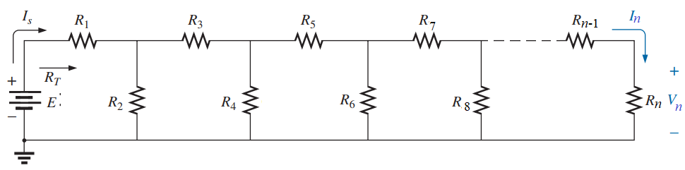
A n-section ladder network appears in the following Figure.
The reason for the terminology is quite obvious for the repetitive structure.
Basically, two approaches are used to solve networks of this type.
(1) Calculate the total resistance and resulting source current, and then work back through the ladder until the desired current or voltage is obtained [Reduce and Return Approach].
(2) Assign a letter symbol to the last branch current (I_{n}) and voltage (V_{n}) and work back through the network to the source, maintaining this assigned current or other current of interest. The desired current can then be found directly.
16

Slide 17
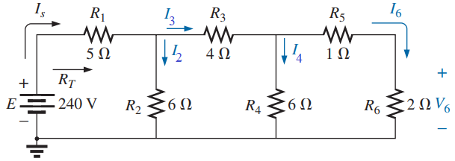
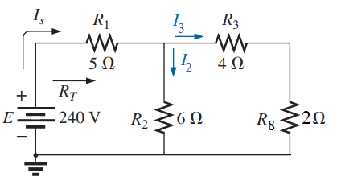
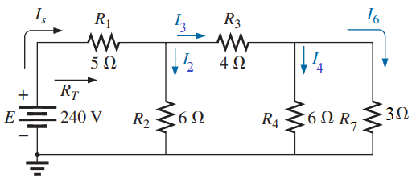
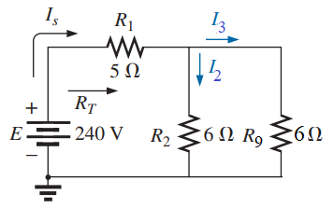
EXAMPLE FIG. 7.3 Determine the unknown currents I_{s}, I₂, I₃, I₄, and I₆ and voltage (V₆) for the following network.
Method 1
(b)
(a)
(c)
17

Slide 18
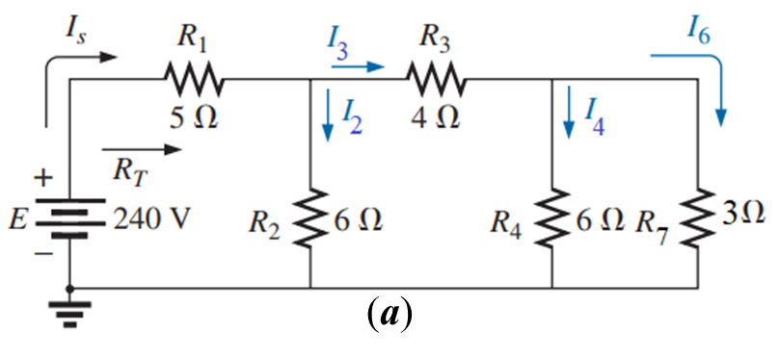
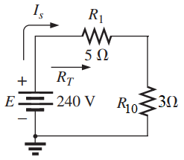
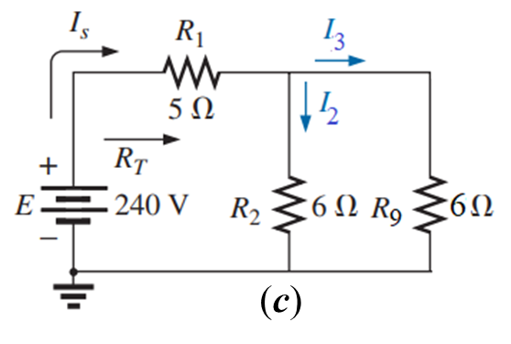
(d)
From Fig. (a), we have:
From Fig. (c), we have:
18

Slide 19
Method 2
The assigned notation for the current through the final branch is I₆:
Practice Problem [SECTIONS 7.6] Problems: 25 ~ 28
19

Slide 20
8.3 SOURCE Transformation
20

Slide 21
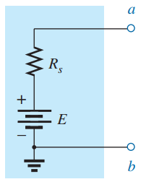
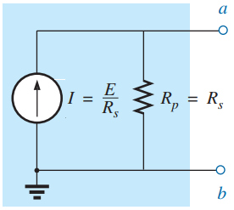
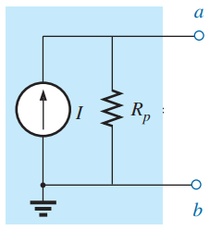
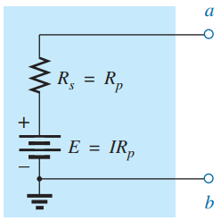
Voltage Source Convert to Current Source
Current Source Convert to Voltage Source
21

Slide 22

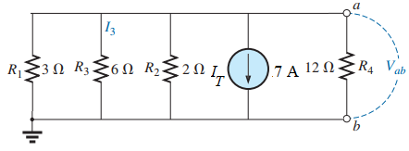
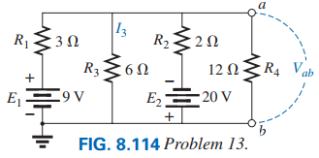
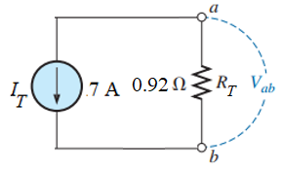
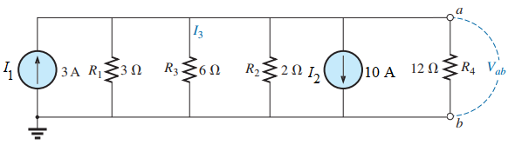
Practice Book [Ch 8]
Problem: 7 ~ 10 and 14
22

Slide 23
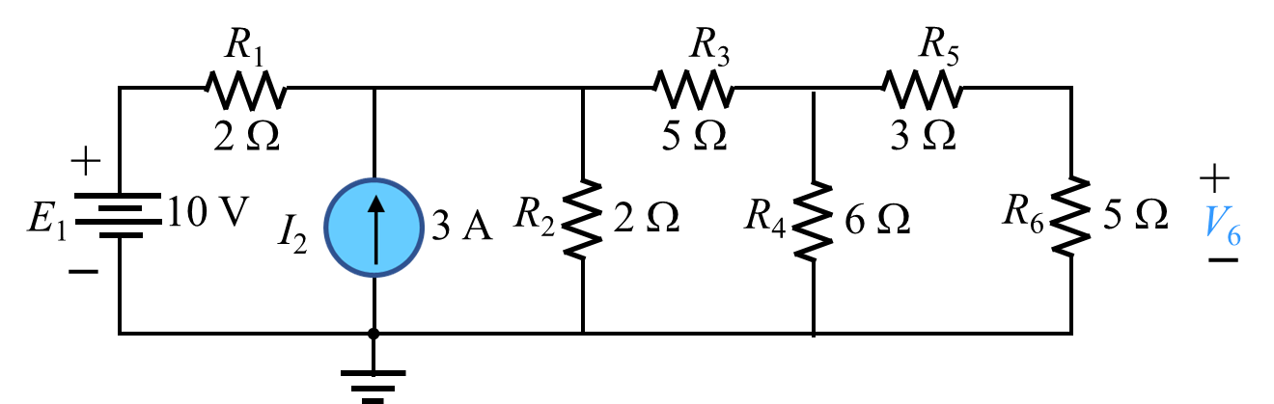





EXAMPLE 8.3.1 Using the source conversion find the value of voltage V₆.
23

Slide 24
More Examples Related to
Series-Parallel Circuits
24

Slide 25


Problem 12 [Ch 7]: For the network in Fig. 7.72: a. Determine the current I₁. b. Calculate the currents I₂ and I₃. c. Determine the voltage levels V_{a} and V_{b}.
25

Slide 26




Problem 10 [Ch 7] Determine the unknown voltage (V) and current (I) for the following network.
V_{sc}=0
26

Slide 27




Problem 26 For the ladder network in Fig. 7.86: a. Determine R_{T}. b. Calculate I. c. Find I₈. d. Power consumed by R₆ resistance. e. Power delivered by the 2 V supply.
27

Slide 28




28

